Slide 1

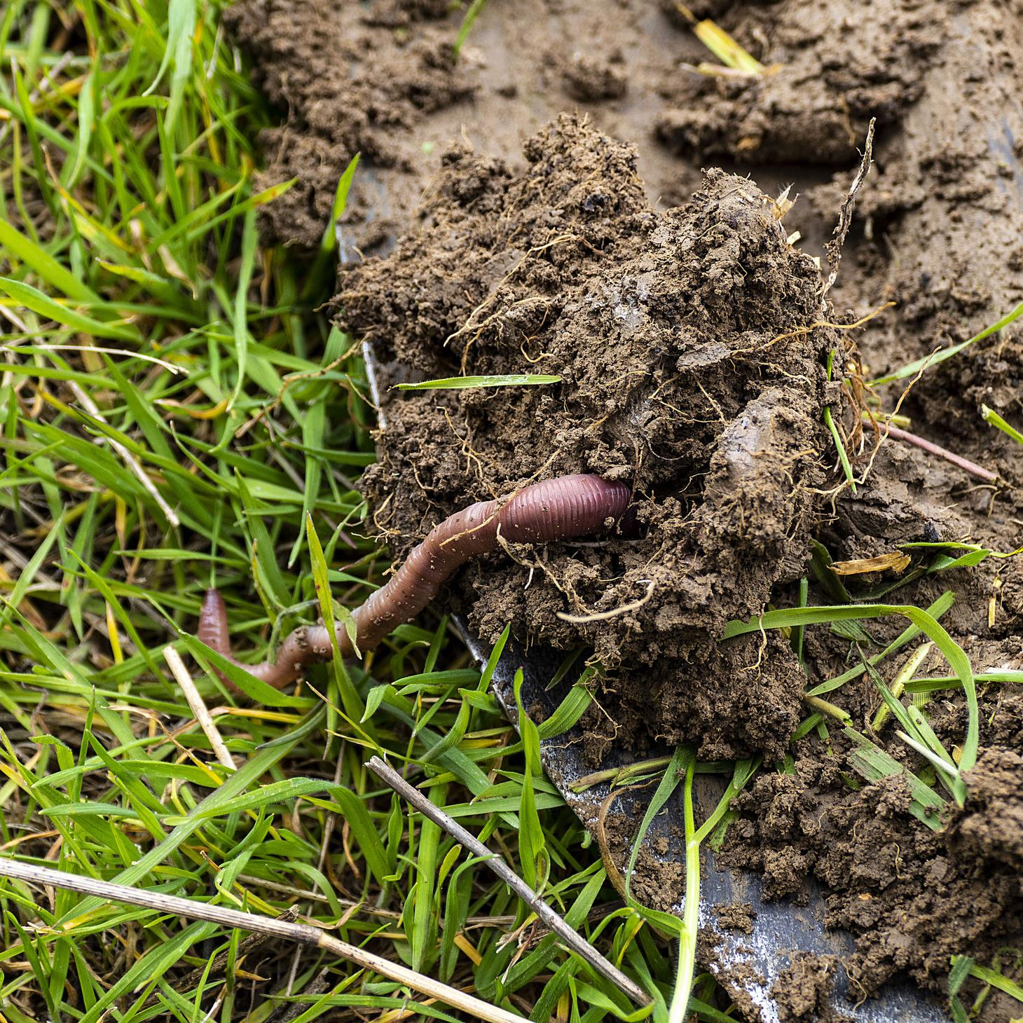



Soils for Europe – supporting the European Mission ‘A Soil Deal for Europe”
Name of presenter
Event / Date / Location
Views and opinions expressed are those of the author(s) only and do not necessarily reflect those of the European Union or the European Commission. Neither the EU nor the EC can be held responsible for them

Slide 2
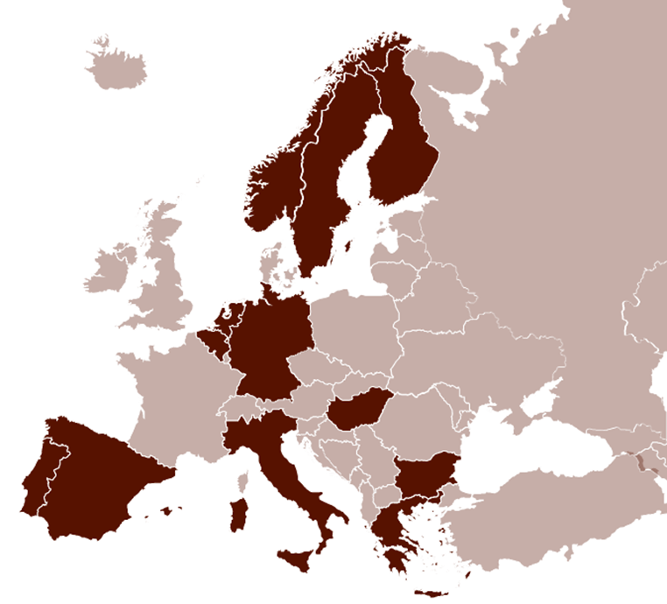


















THE TEAM BEHIND SOLO
17 partner organisations across 11 EU member states and Norway
SOLO’s consortium comprises a European network of established professionals from companies, sector organisations and the academia

Slide 3


WORK PACKAGES
WP1
Project Management and Coordination
WP2
Soil Mission Think Tanks
WP3 Drivers of soil health
WP4 Roadmaps Integration
WP5
Operational Framework

Slide 4
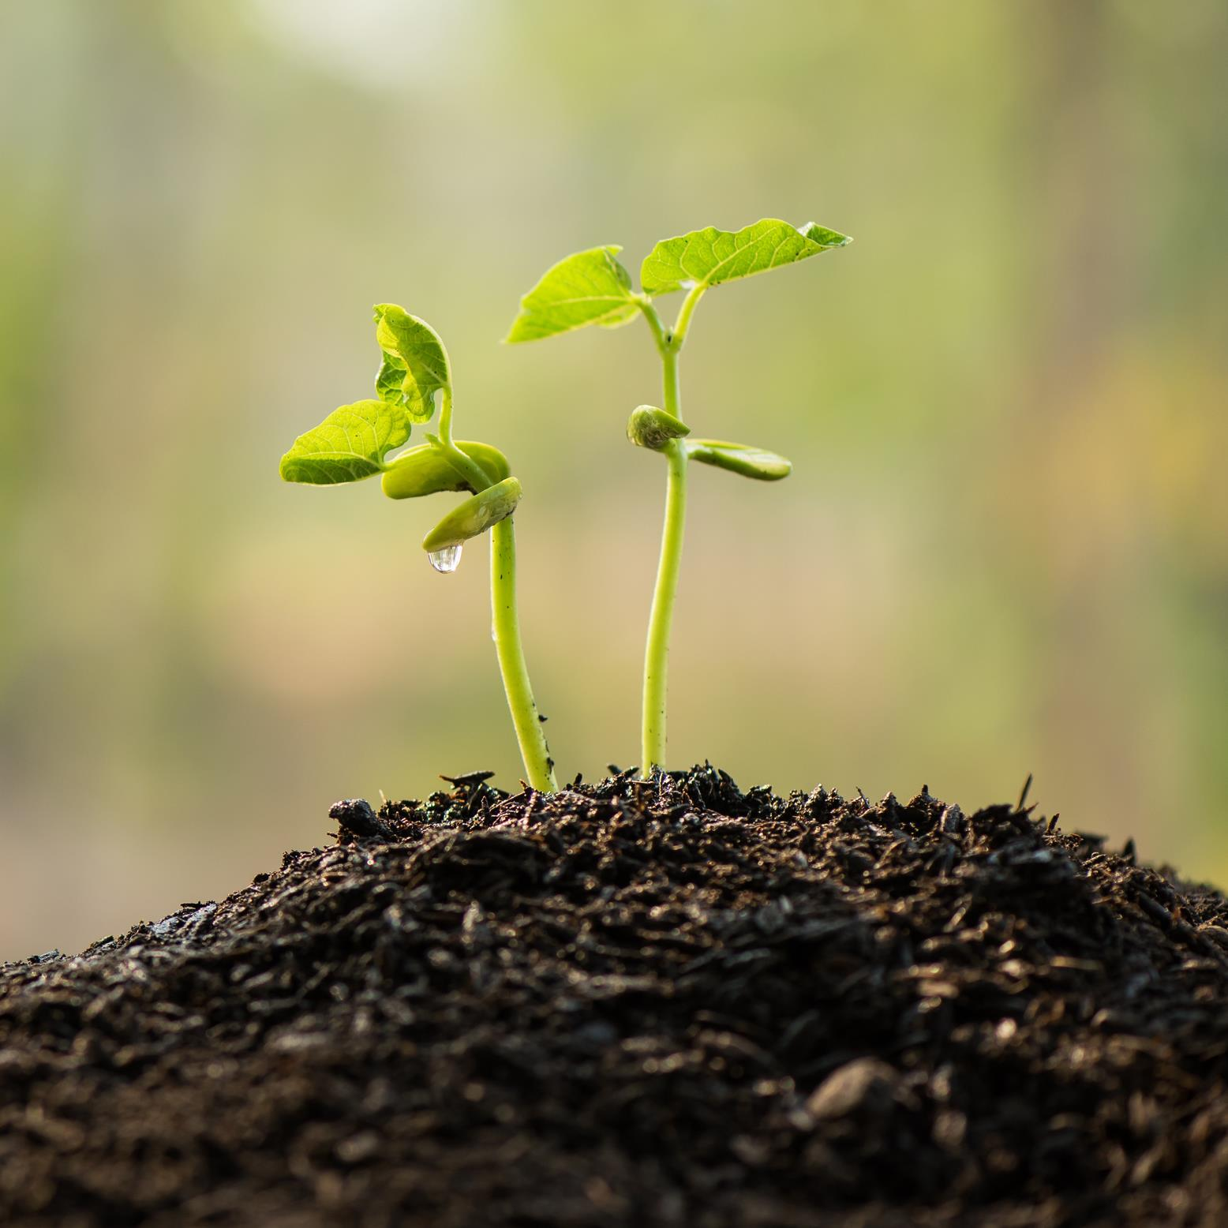
BACKGROUND
Healthy soils are essential for life on Earth as they are the foundation of our food systems. They provide clean water and habitats for biodiversity while contributing to climate resilience and support our cultural heritage and landscapes and is the basis of our economy and prosperity.
Soils are under multiple pressures, including climate change, urbanization, pollution, overexploitation, nutrient mining and biodiversity loss with the European Commission estimating that under current management practices, 60-70% of our soils are unhealthy.

Slide 5



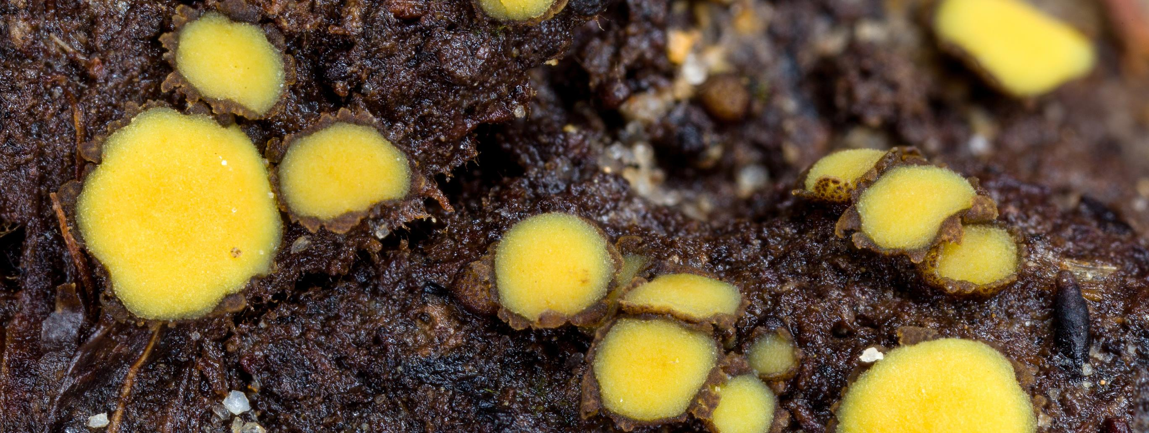
OUR GOALS
SOLO will identify current knowledge gaps, drivers, bottlenecks, and novel research and innovation approaches to be considered in the European Soil Mission research and innovation roadmap.
SOLO will provide contextualised solutions, acknowledging that soil needs are stakeholder and location specific.
The project aims to create a knowledge hub for soil health research and innovation that will last beyond the project's lifespan by establishing strategic partnerships and by implementing a participatory and transparent process.

Slide 6

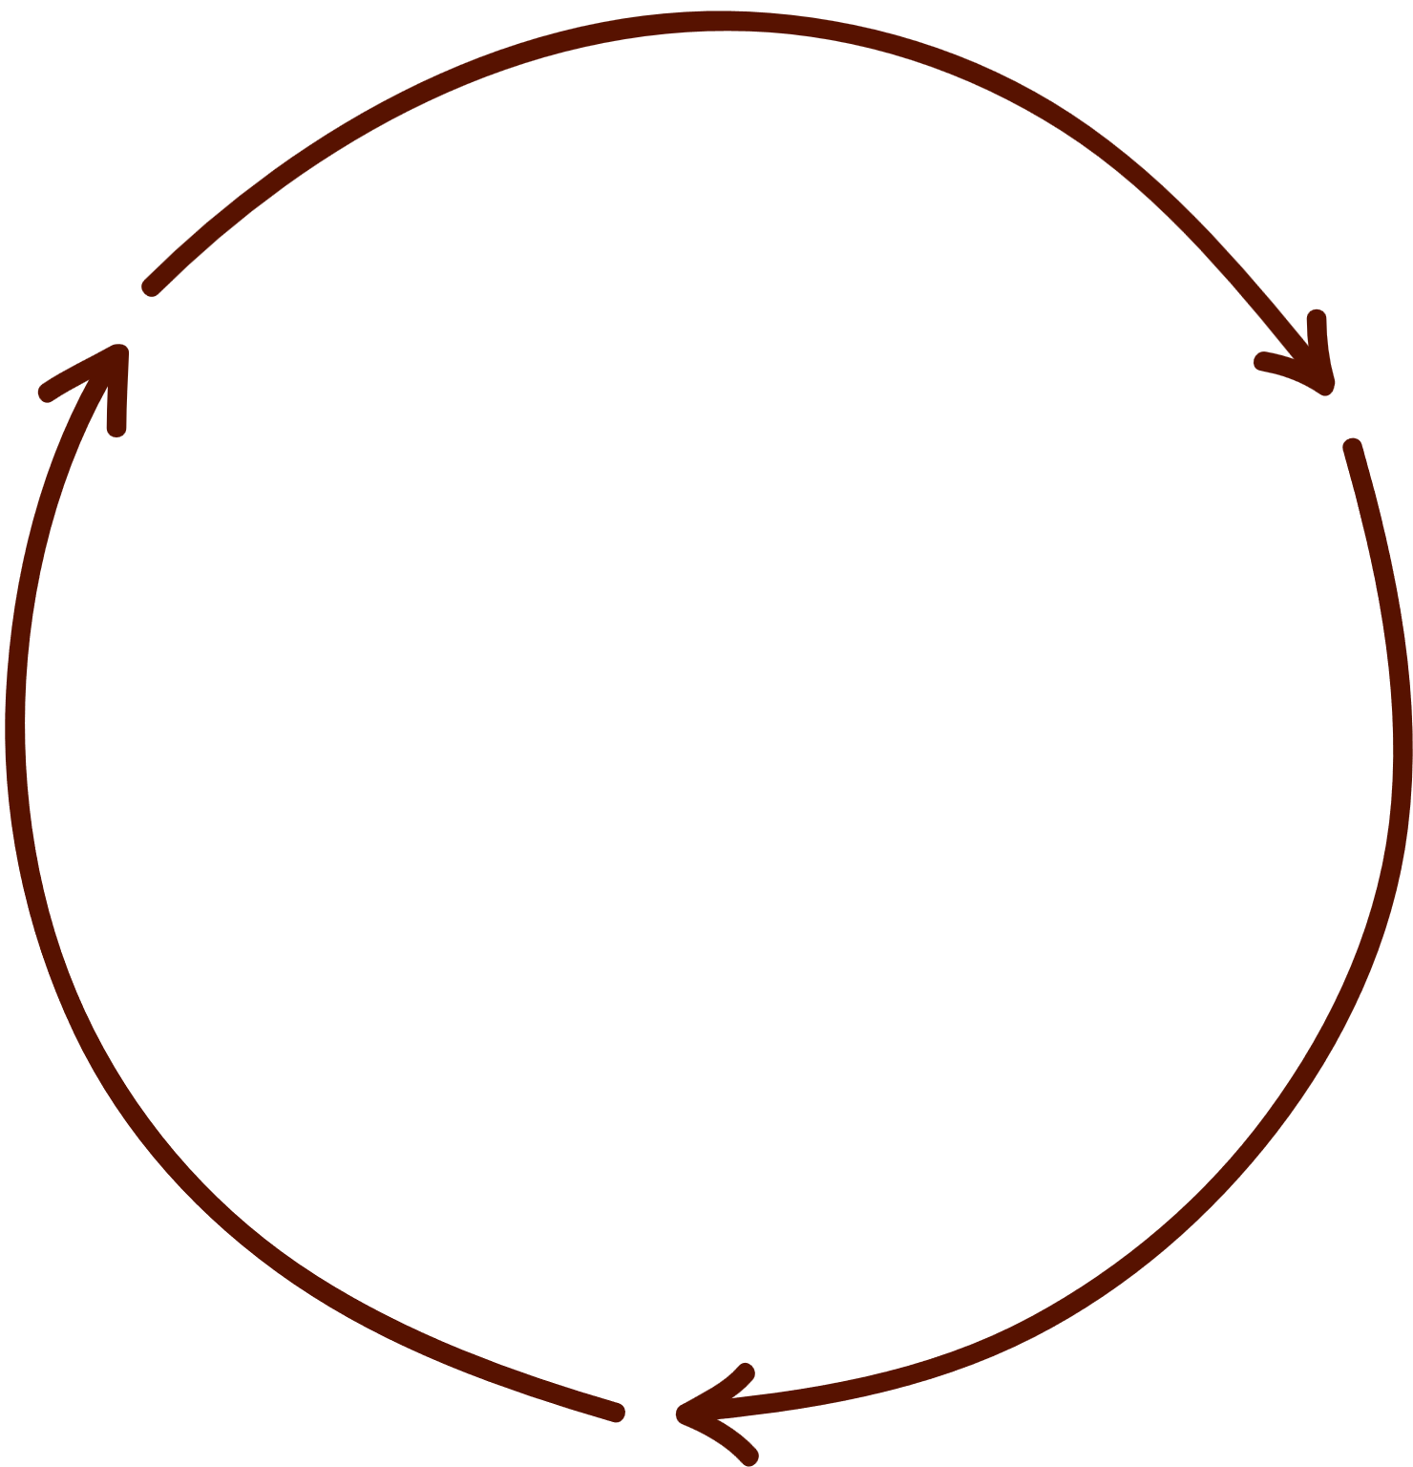




INTEGRATING R&I ROADMAPS THE SOIL MISSION OBJECTIVES AND PROJECTS DEALING WITH R&I ROADMAPS
Sectorial topics
Transdisciplinary research and innovation roadmaps (balance between basic research and transdisciplinary research)
Tradeoff assessments and prioritization
Synthesis
Thematic roadmaps
Thematic experts
Horizontal Integration
Implementation of Think Tanks across Soil Mission Objectives
Collaboration and enrichment of the current EUSO Forum
SOLO aims to act as a focal point across current and future EU projects that include the development of topic-specific R&I roadmaps

Slide 7










THINK TANKS IN SUPPORT OF THE MISSION AND EUSO
At the core of SOLO will be the implementation of the Think Tanks, one for each Soil Mission objective, with the aim of co-creating knowledge and identifying the knowledge gaps, drivers, bottlenecks, and novel approaches, as well as suggesting KPIs to monitor the progress of the Mission R&I related activities.
Erosion Prevention
Land degradation
Footprint
on soils
Soil organic carbon stocks
Pollution and restoration
Soil sealing and urban soils
Soil
structure
Soil
literacy
Nature conservation of soil biodiversity
Climate smart agriculture

Slide 8


DEVELOP OBJECTIVE-SPECIFIC R&I ROADMAPS
soil scientists
economists
climate scientists
educators
food quality and safety organizations
impact assessment agencies
State of the art
R&I Gaps
Funding priorities
governance specialists
consumer organizations
social scientists
ecologists
corporations
policy and lawmakers
NGOs
retailers
restoration and remediation organizations
space agencies
earth observation researchers

Slide 9
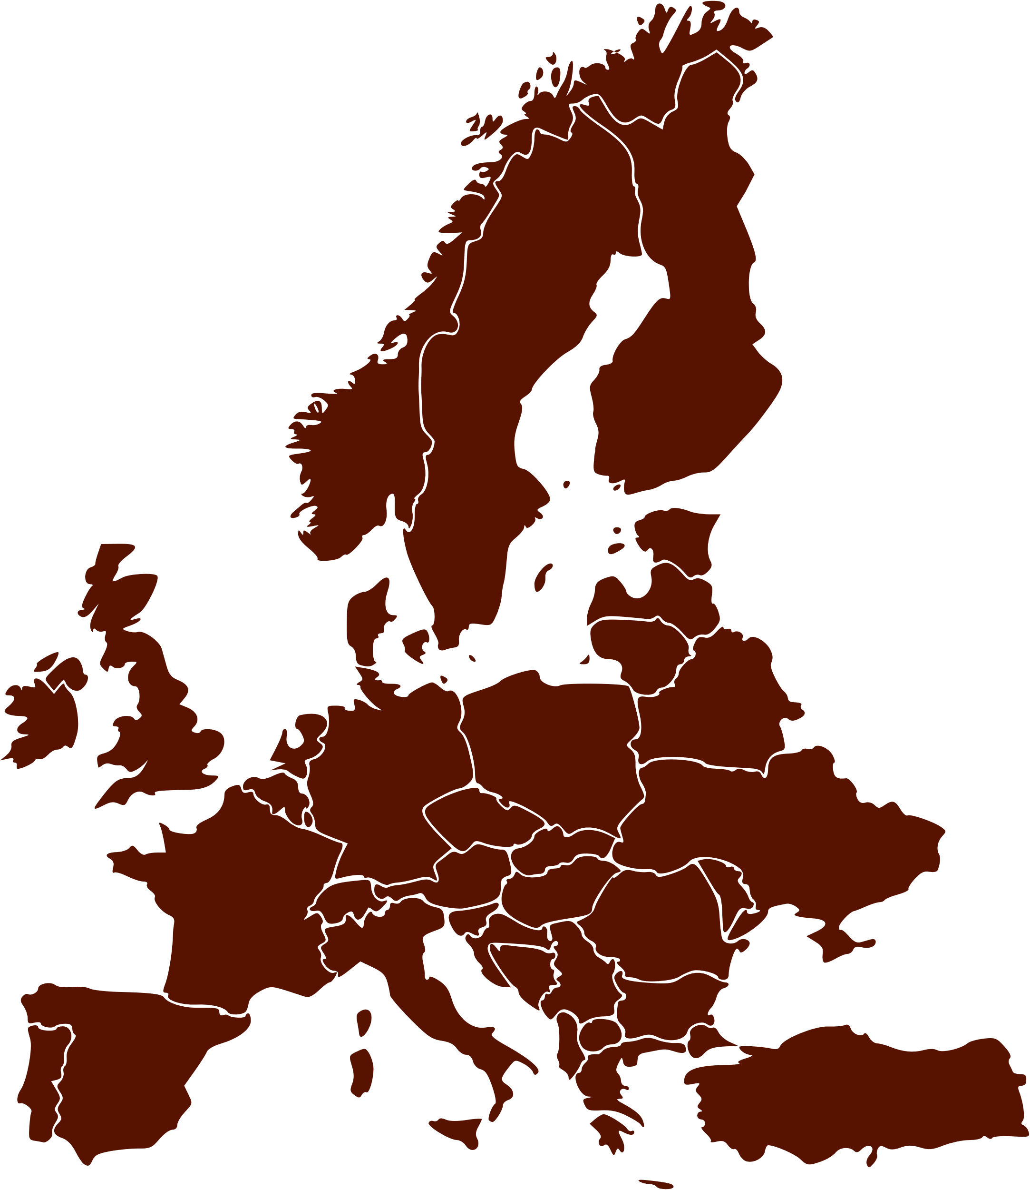


PROVIDING AN EUROPEAN R&I ROADMAP THAT INCLUDES
a regionalization of the identified priorities
Europe
Vertical Integration
Sectorial topics
National/regional focus
Tradeoff assessments and prioritization
Transdisciplinary research and innovation roadmaps (balance between basic research and transdisciplinary research)
Synthesis
Thematic roadmaps
Horizontal Integration
Overall European R&I roadmap for the next decade
Recognize the need to have these priorities regionalized across different countries
Challenges with cross-border integration of research funding
Thematic experts

Slide 10

Multiple worldviews
Different ontologies
Different cultural backgrounds
Europe
Links to the European Soil Observatory
Market driven economy
Sectorial policies
Vertical Integration
Opportunity to focus on regional knowledge gaps
Sectorial research funding
National/regional focus
Structural policies on soil health
Integrative research funding
Sectorial topics
Circular economy
Links to the Living Labs and the proposed soil districts
Tradeoff assessments and prioritization
Transdisciplinary research and innovation roadmaps (balance between basic research and transdisciplinary research)
Synthesis
Thematic roadmaps
Transition to...
Thematic experts
Horizontal Integration

Slide 11
Multiple worldviews
Different ontologies
Different cultural backgrounds
Europe
Operational Framework
Key Progress Indicators
Links to the European Soil Observatory
Sectorial topics
Sectorial policies
Vertical Integration
Opportunity to focus on regional knowledge gaps
Soil weeks
National/regional focus
Sectorial research funding
Soil Network of Knowledge
Structural policies on soil health
Integrative research funding
Sectorial topics
Regional Nodes
Circular economy
Links to the Living Labs and the proposed soil districts
Tradeoff assessments and prioritization
Transdisciplinary research and innovation roadmaps (balance between basic research and transdisciplinary research)
Overarching Roadmaps
Think Tanks
Synthesis
Drivers Assessment
Thematic roadmaps
Transition to...
Thematic experts
Horizontal Integration

Slide 12














CONTRIBUTING TO THE MONITORING of Research & Innovation KPIs
List of Research and Innovation Key Performance Indicators
Operational framework to report and monitor the success of the R&I Soil Mission activities
Identification of the relevant reporting mechanisms
CONSULTATION BOARD
Mission Board
DG RTD
DG SANTE

Slide 13





WHERE TO FIND US
www.soils4europe.eu
@soils4europe
Soils for Europe

Slide 14

THANK YOU!

